Slide 1


ACADEMY MANAGEMENT SYSTEM
Notes:
NOTE:
To change the image on this slide, select the picture and delete it. Then click the Pictures icon in the placeholder to insert your own image.

Slide 2
AGENDA
Problem
Goals
Development
Future Goals

Slide 3



Problem
To automate the Administrative Process
Improve Communication and Collaborations
Privacy
Reduce the Cost of Labor
Providing Efficient Record Management

Slide 4
GOALS
To help the Academies and Coaching centers
Managing these Academic activities.
Using this system (with a bit modification), can reduce their excessive work, with efficient Record management and privacy.

Slide 5
USERS
Admin
Student
Staff

Slide 6
FUNCTIONALITIES FOR ADMIN
View Overall Activities at Campus
Manage Student
Manage Staff
Manage Classes
Manage Subjects
Manage Session Years
View Attendence
Student/Staff Feedback

Slide 7
FUNCTIONALITIES FOR STAFF
Manage Attendance
Give Feedback
Apply Leave
Add Result
Check Students Under him

Slide 8
FUNCTIONALITIES FOR STUDENT
View Subjects Enrolled
Give Feedback
Apply For Leave
View Result
View Attendance

Slide 9

NON-FUNCTIONAL REQUIREMENTS
Security Requirements
User-Friendly Interface
System Requirement

Slide 10
DEVELOPMENT
HTML
CSS
MySQL
Django
Bootstrap

Slide 11
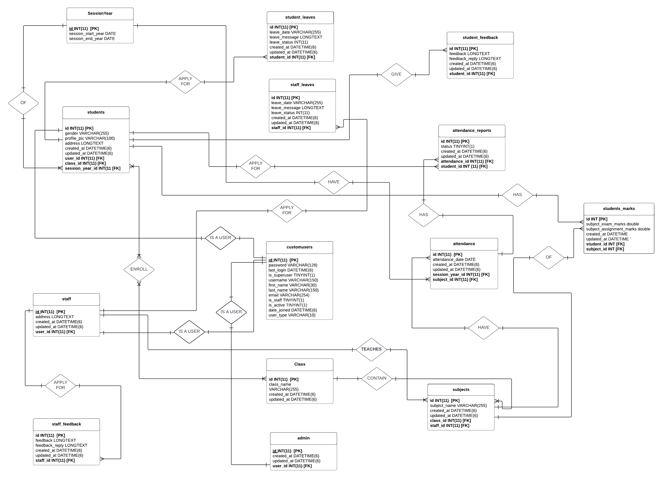
RELATIONAL MODEL

Slide 13
A GLIMPSE OVER THE USER INTERFACE

Slide 14
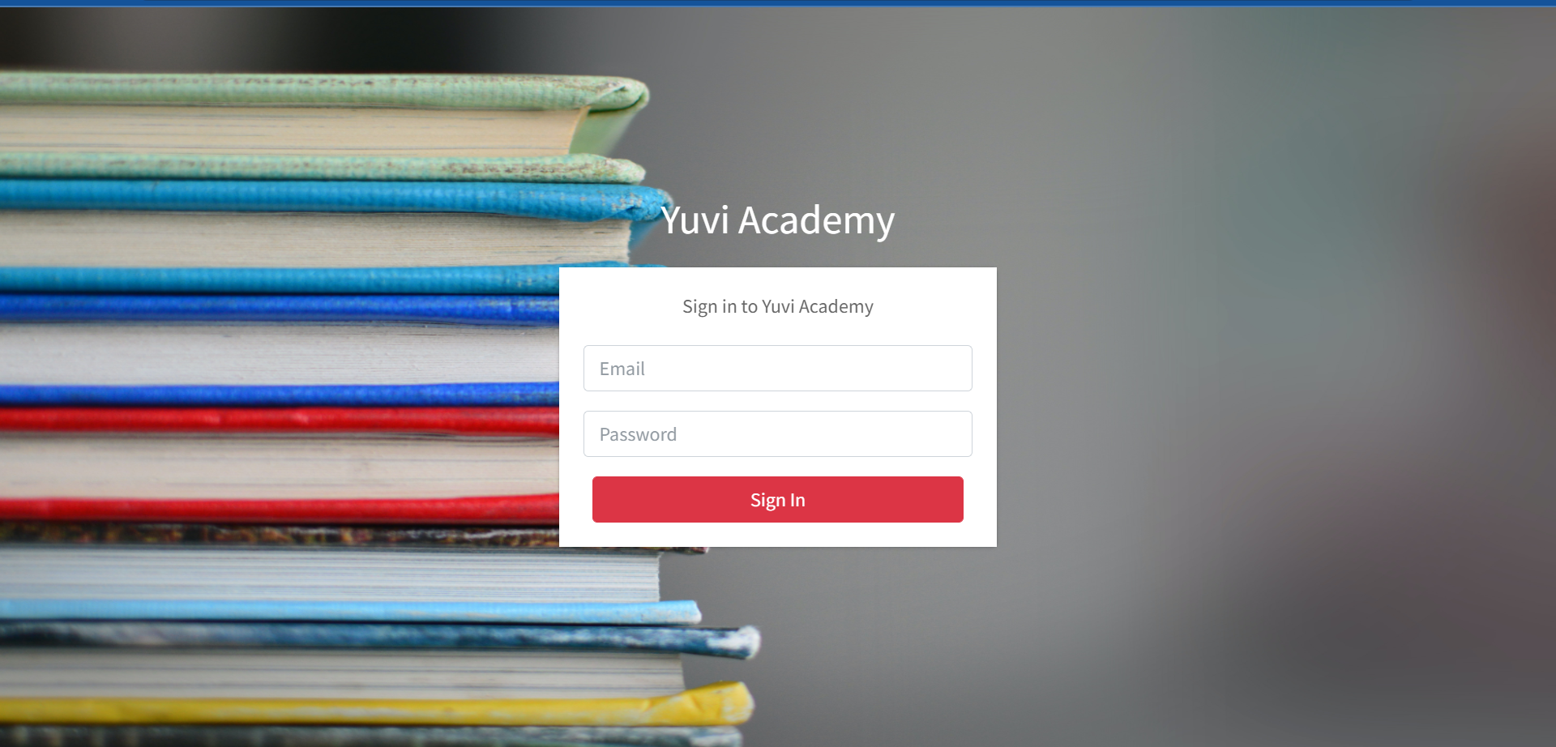
Login Page

Slide 15
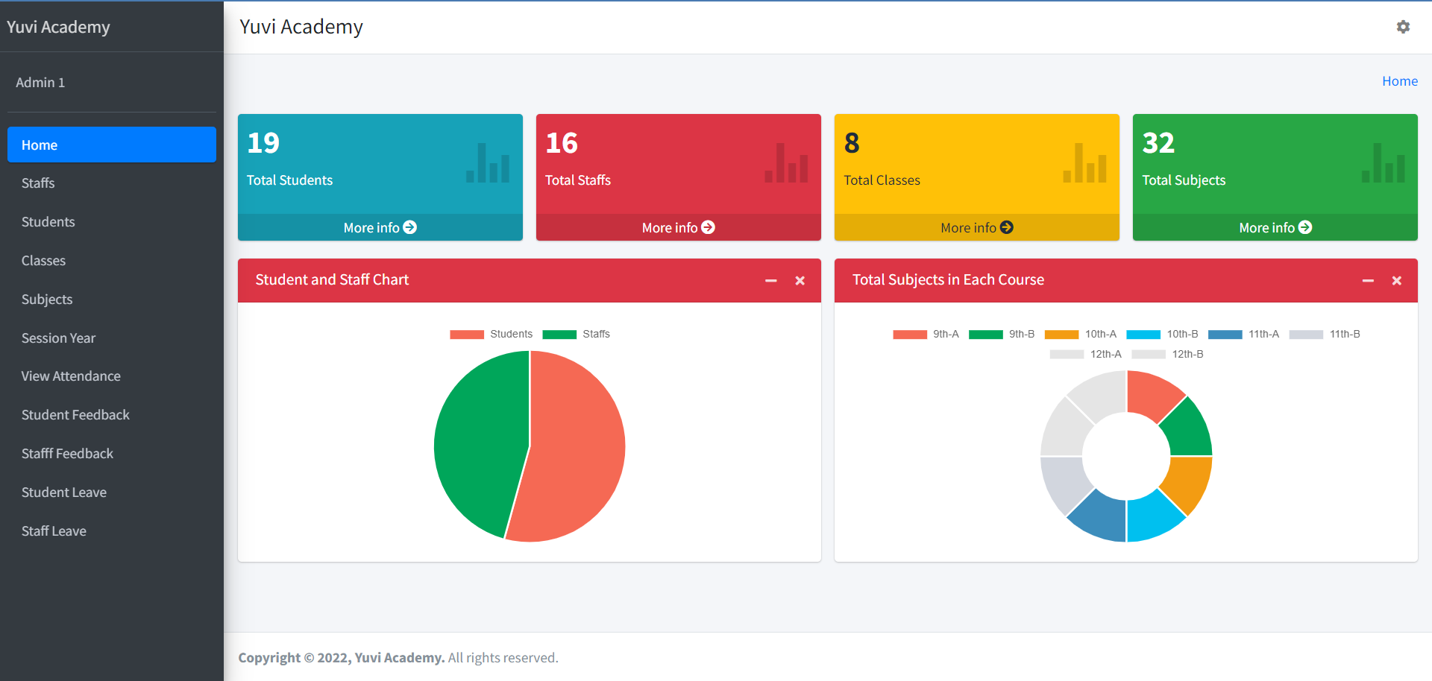
For Admin

Slide 16
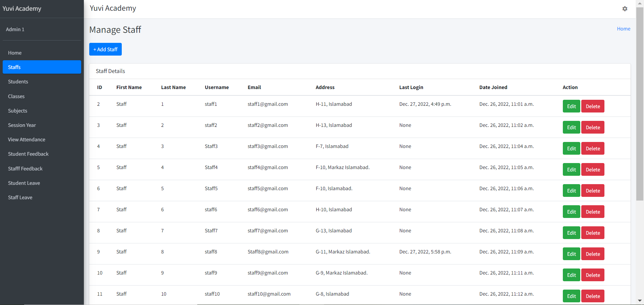
Contd.

Slide 17
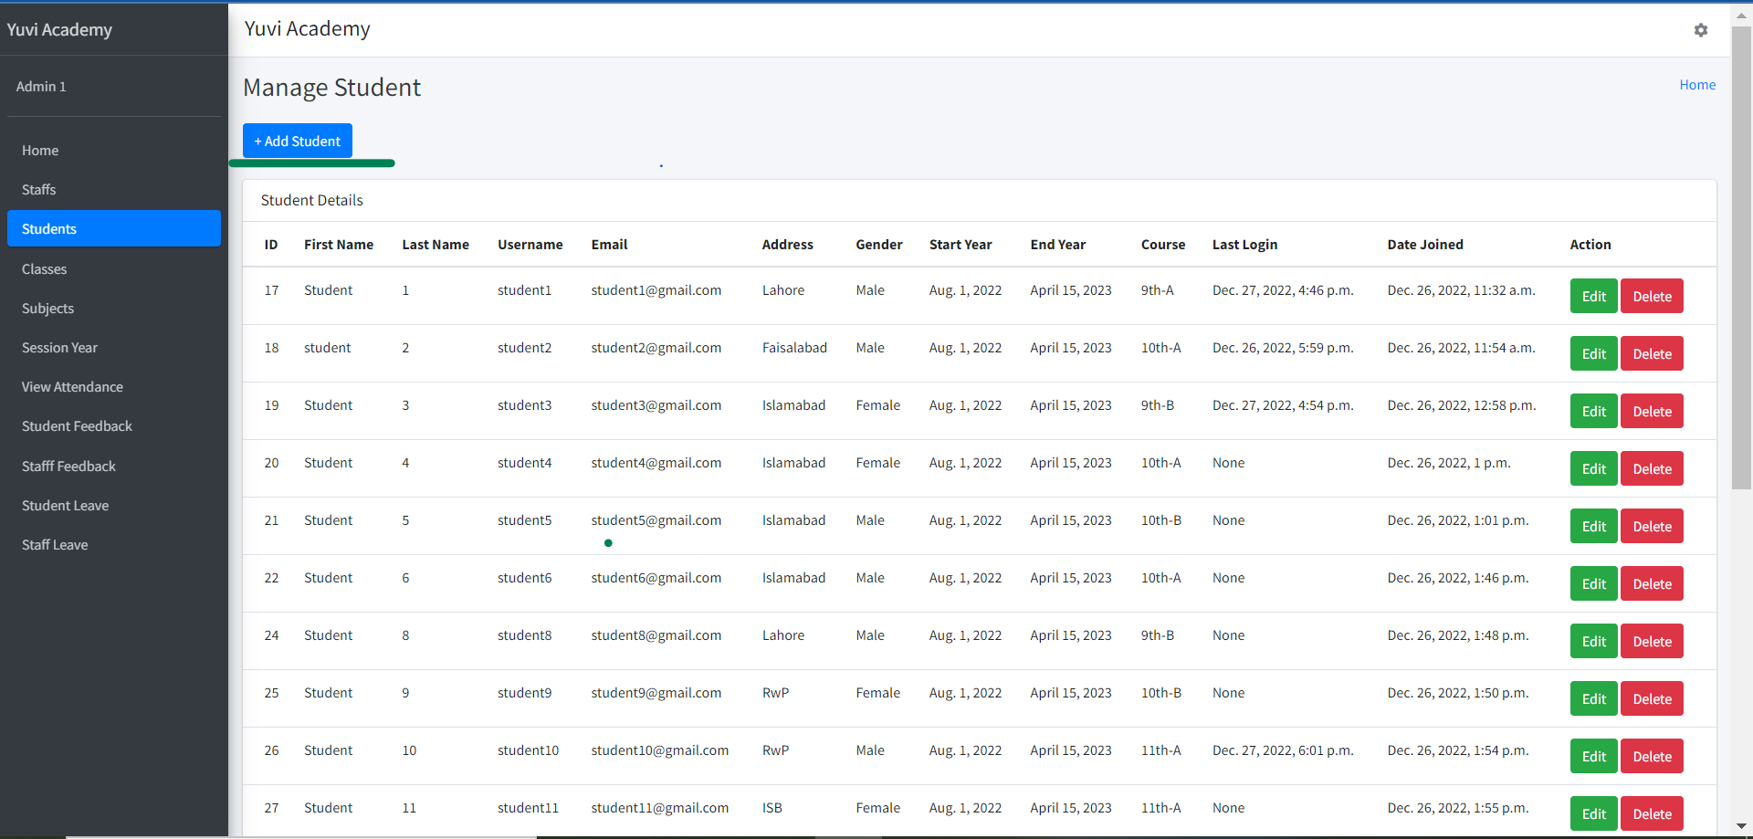
Contd.

Slide 18
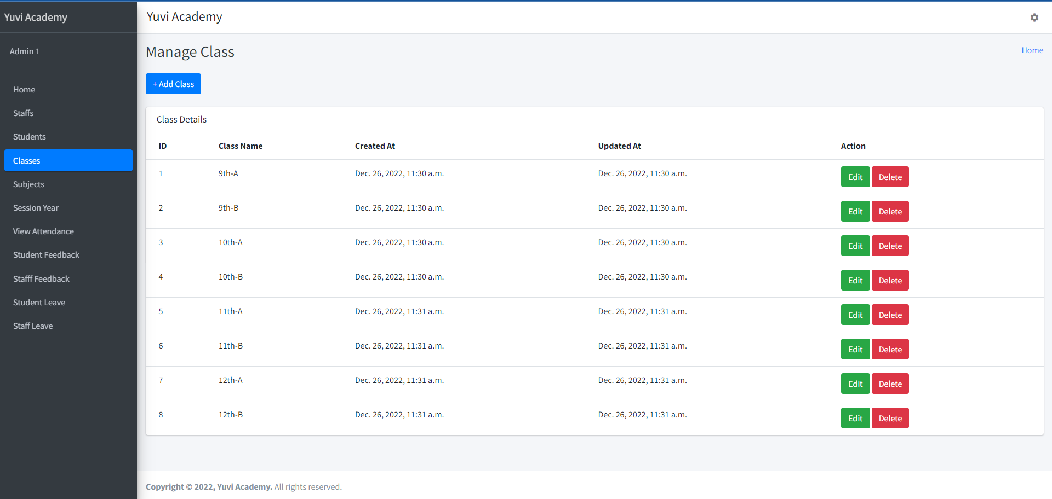
Contd.

Slide 19
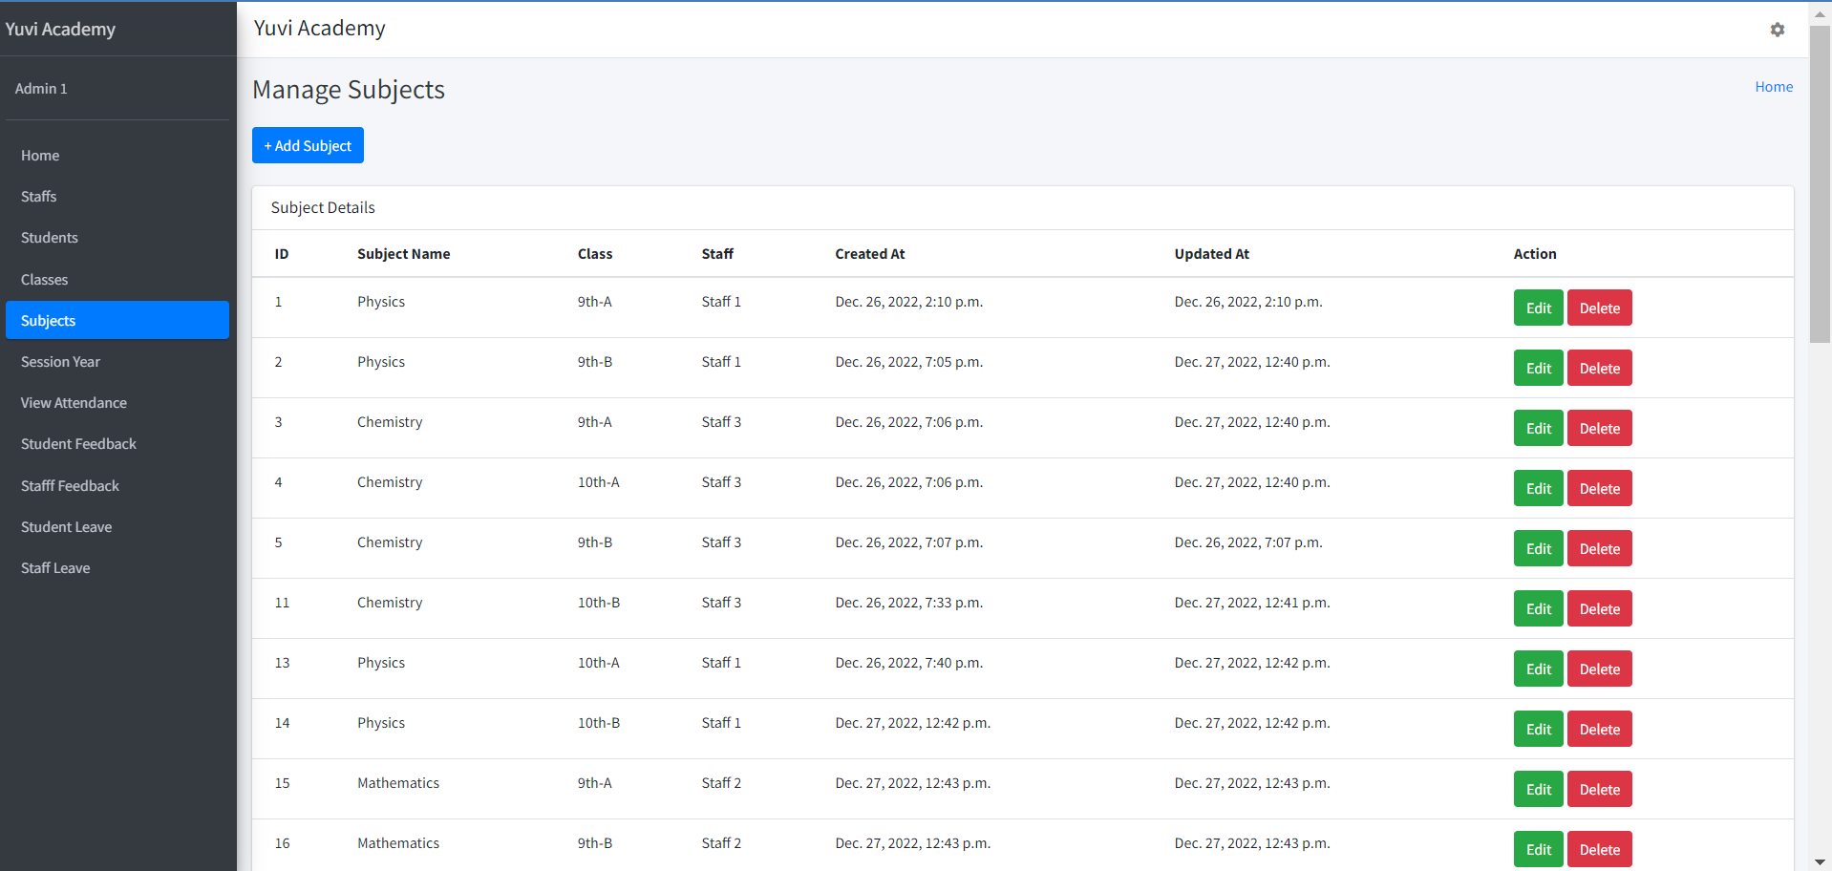
Contd.

Slide 20
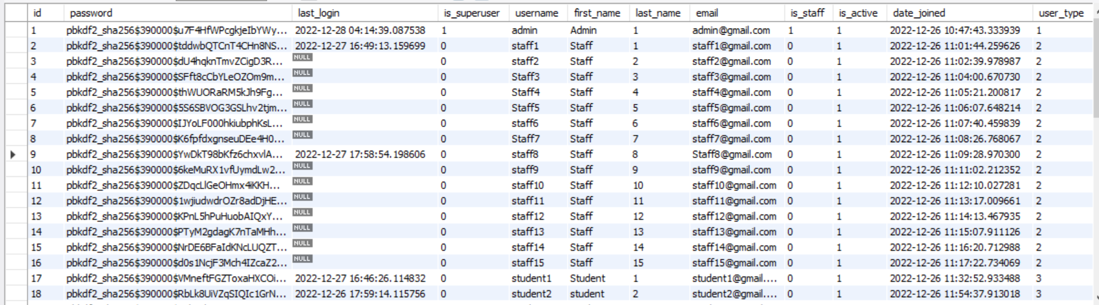
Contd.
The database from which we are fetching these results.
Similarly, other details of the Student and Staff are also saved in their respective Tables. We’ll demonstrate them in the DEMO.

Slide 21
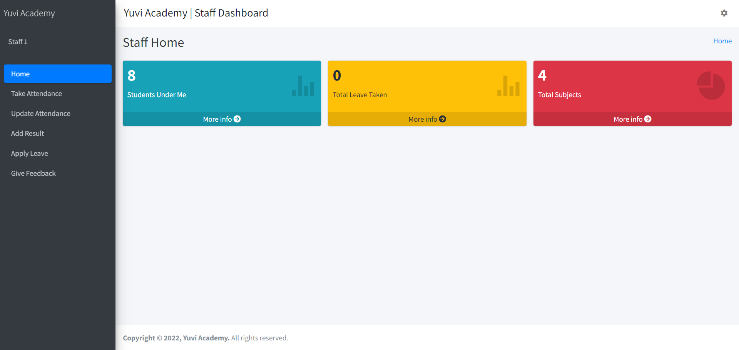
For Staff

Slide 22
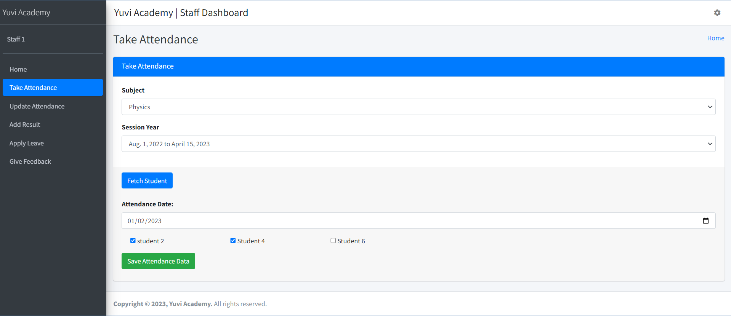
Contd.

Slide 23
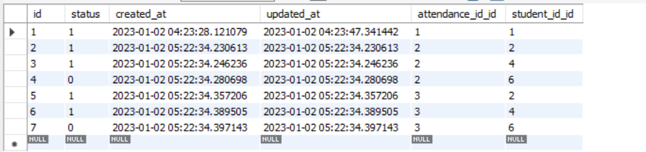
Contd.

Slide 24
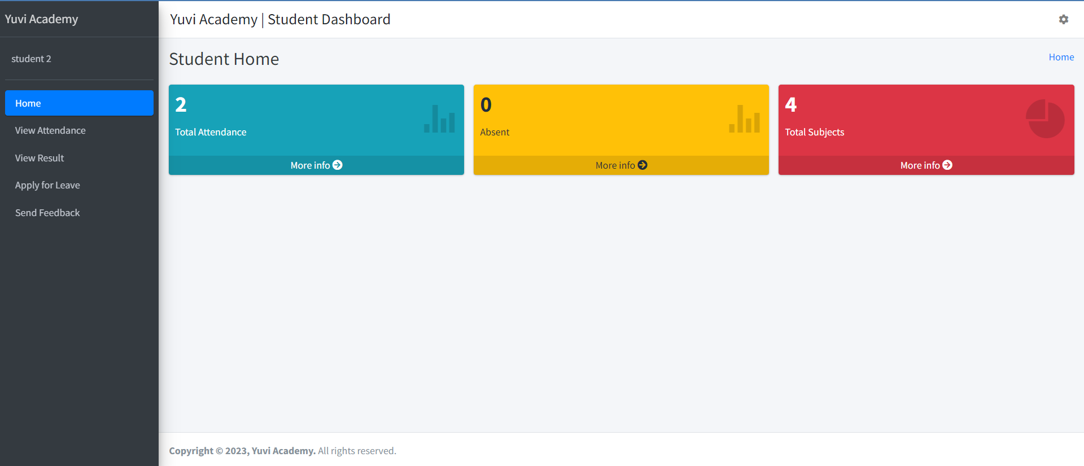
For Student

Slide 25
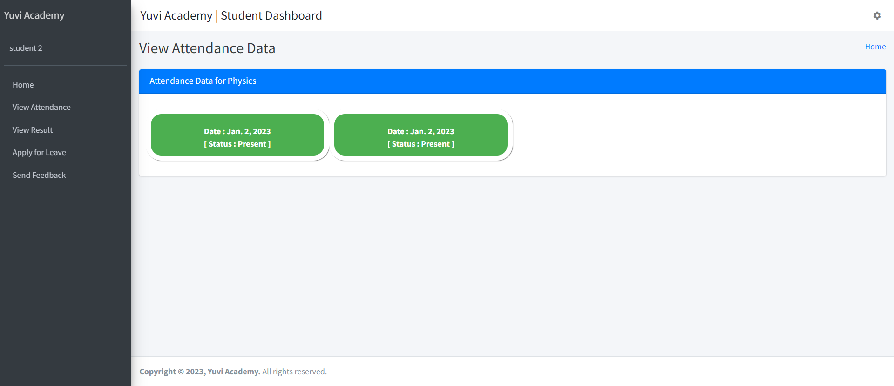
For Student

Slide 26
A WAY FORWARD
A Decentralized App
Email System
Online Fee Management
Addition of a Parent Portal
Grading system

Slide 27
THANK YOU

